Slide 1

The orchestration engine
for enterprise multimedia.
PREPARED FOR
Client logo
Notes:
Drop the client logo in the slot below Prepared for. Cover line is the tagline - leave it.

Slide 2
AGENDA
Here is how we will spend our time.
01 Review of scope
02 Why LUCI was created
03 The LUCI solution
04 What is included
05 The LUCI value
06 The team
07 Our clients
08 What happens next - then the demo
02
LUCI
Notes:
Your roadmap. Say it, move on. The team and the two journey slides belong on the agenda.

Slide 3
REVIEW OF SCOPE
The floor we will orchestrate.
Video - edit to the room
Signage - edit to the room
Audio - edit to the room
Lighting - edit to the room
Hero photo
03
LUCI
Notes:
The thin early-call slide Mark talks. Edit the four lines to the property. Spoken close: ask for a DSP file and a display count.

Slide 4
WHY LUCI WAS CREATED
Custom systems were the problem.
We came up as integrators, owners, and operators. Early versions of this idea ran inside casino properties. The custom systems were slow to deploy, hard to maintain, and rigid when the property changed. LUCI is the standard that replaced them.
04
LUCI
Notes:
The one slide in Mike voice. Spoken off-slide: fifty years and the Ameristar and Pinnacle names. The logo wall carries proof visually.

Slide 5
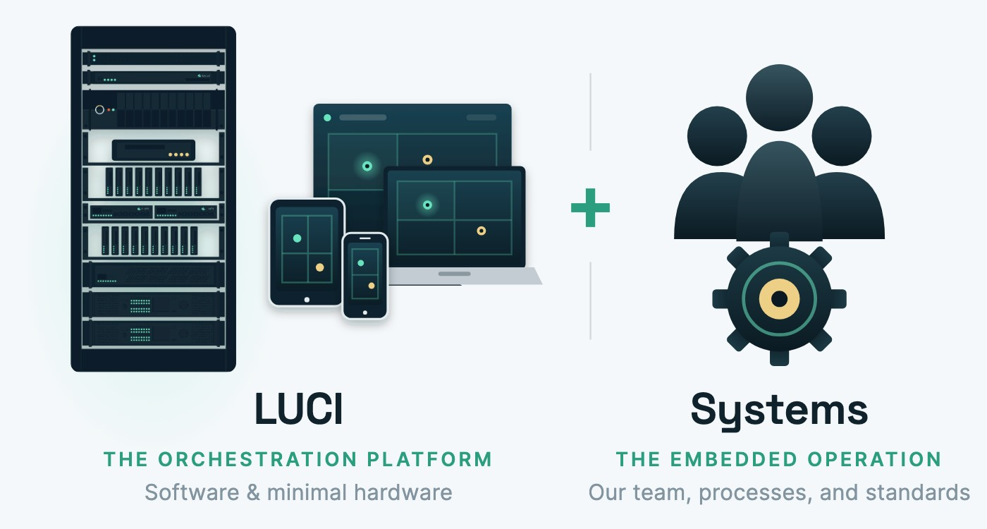
THE LUCI SOLUTION
Two forces working as one.
- Complete visibility across your property
- Align your teams by default
- Fully activate the guest experience
- An A/V platform that scales and improves
05
LUCI
Notes:
Defines the solution: platform plus embedded team. Four lines under the diagram.

Slide 6
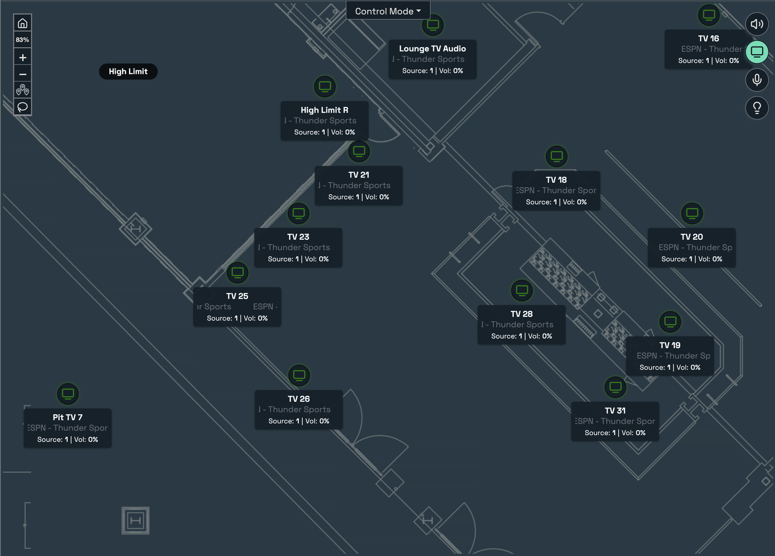
THE LUCI SOLUTION
One interface to control, automate, and execute the entire guest experience.
01 Control
Adjust lights, sound, screens, signage - any zone, by hand or auto.
02 Automate
Build scenes once - game time, happy hour, morning reset.
03 Execute
The whole room delivers the moment, in sync - no staff scrambling.
06
LUCI
Notes:
The screen the old materials never showed. Walk the floor view, then the three verbs.

Slide 7
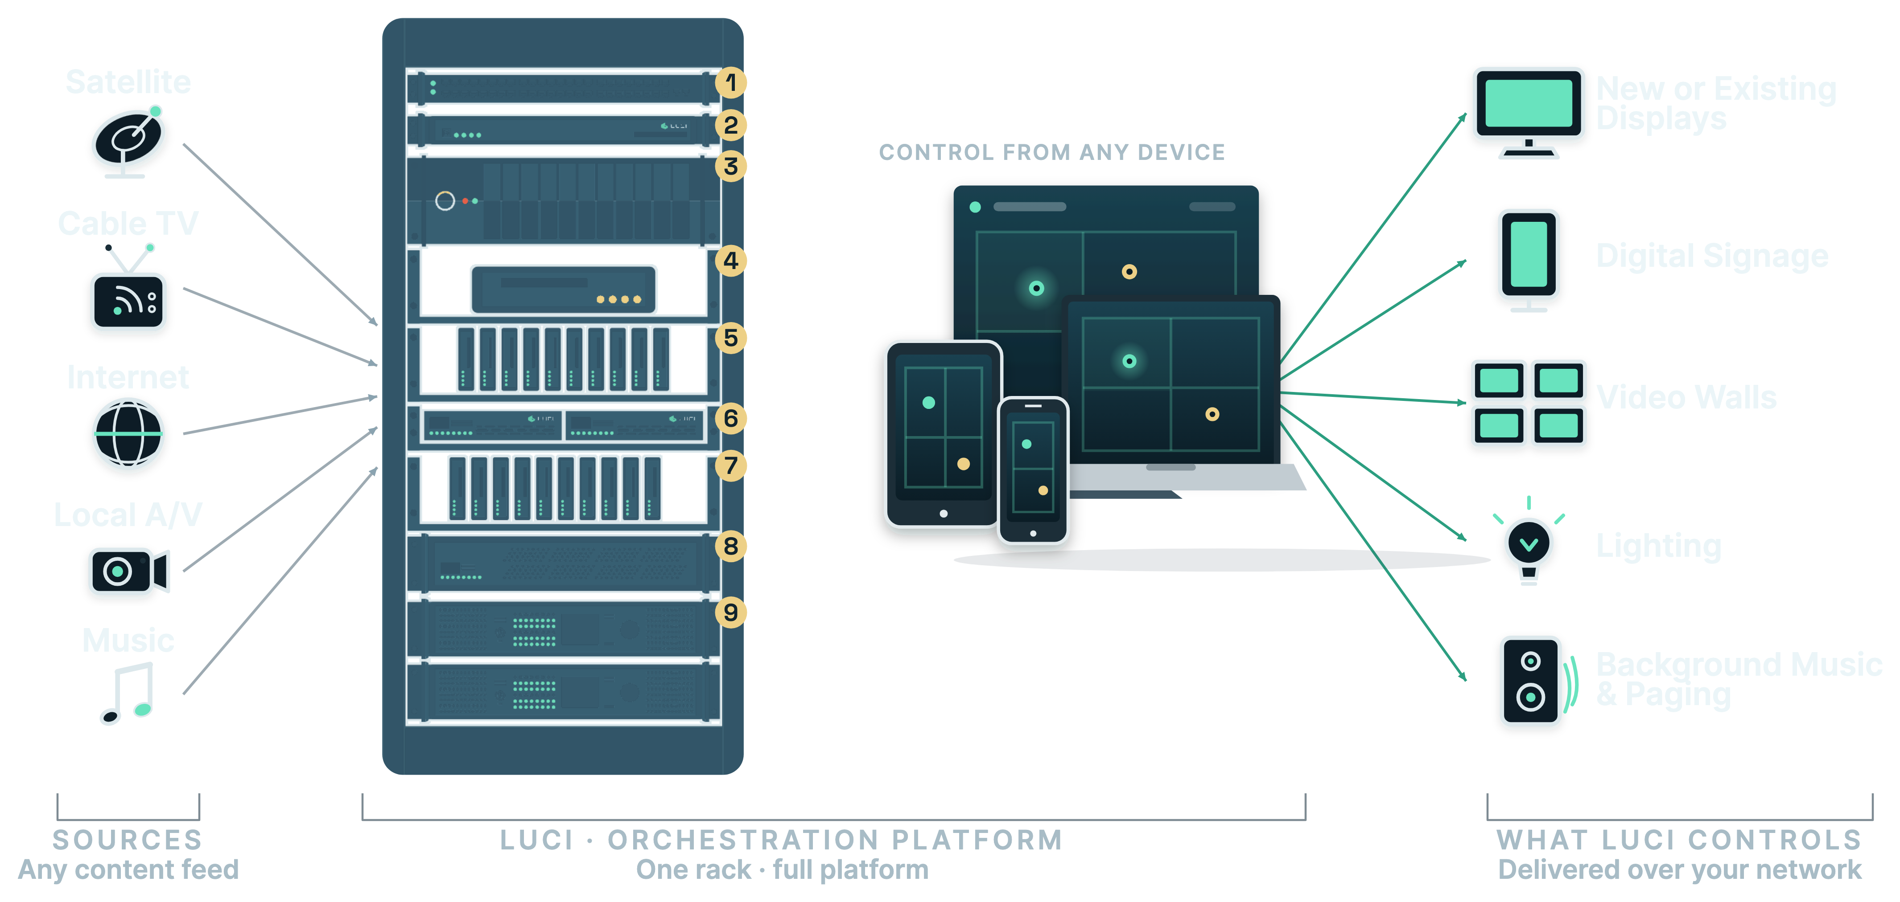
THE LUCI SOLUTION
How LUCI connects.
07
LUCI
Notes:
The application guide. Sources in, one rack, out to displays, signage, walls, lighting, audio. Point at the rack.

Slide 8
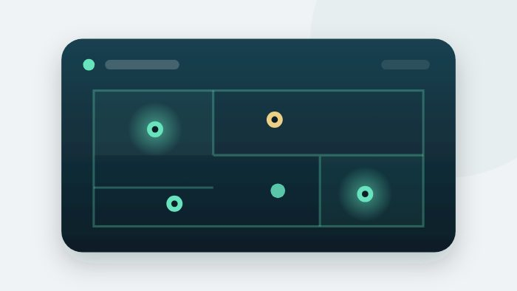
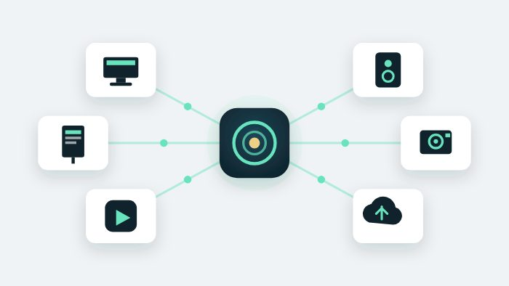
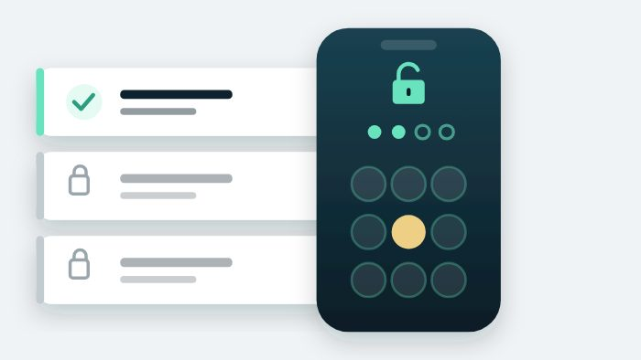

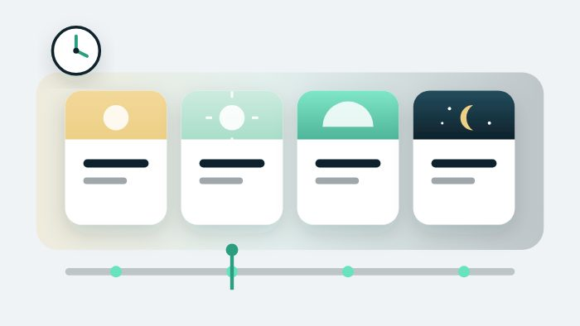
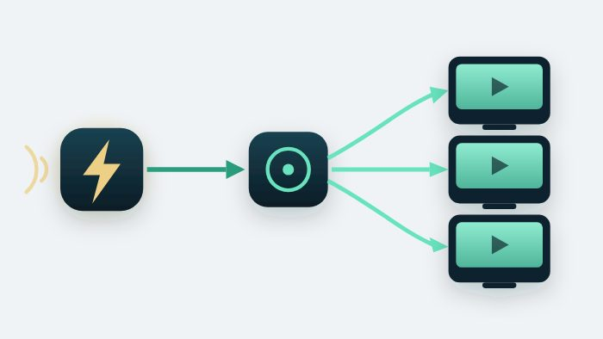
WHAT IS INCLUDED
Six capabilities define the platform
Map-based dashboard
Open integration
PIN-delegated control
Predictive monitoring and alerts
Presets and scheduling
Automation and triggers
08
LUCI
Notes:
What is included: the six capabilities. Skim them in an executive room; talk the ledger next.

Slide 9
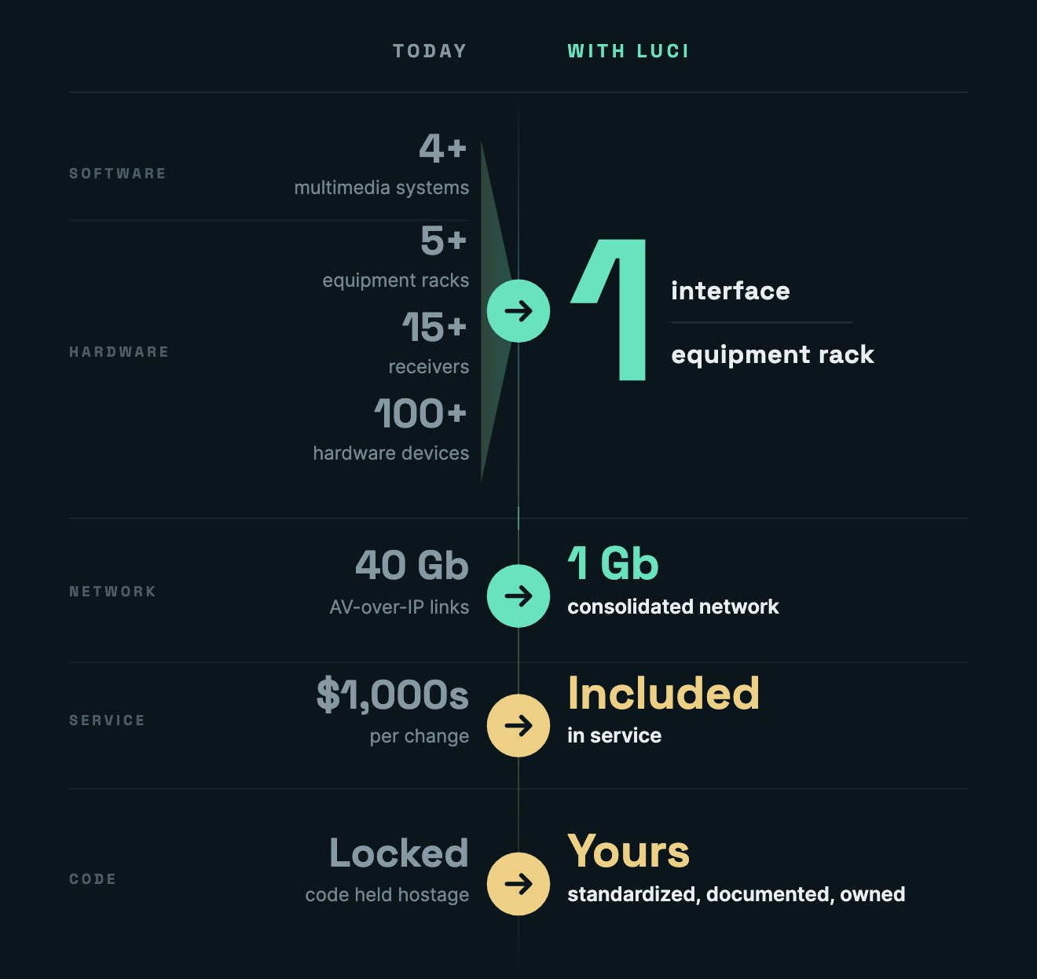
THE LUCI VALUE
Less hardware. Fewer vendors. Your team in control.
09
LUCI
Notes:
The lightbulb. Racks of gear down to one rack. Replaces the old percentage slide. Stand on the counts already on the diagram.

Slide 10
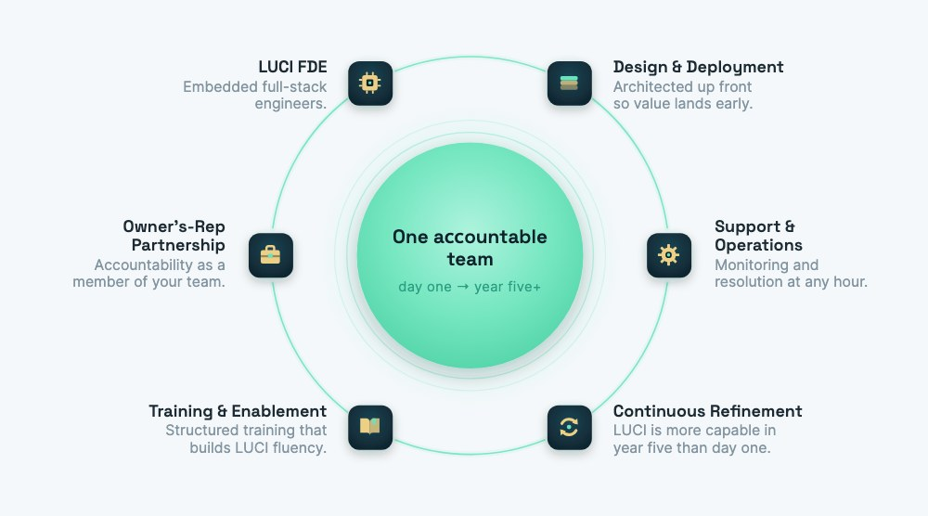
THE TEAM
The team that builds it runs it.
10
LUCI
Notes:
The consultative-support beat. One accountable team from design through year five. Mike can still say the director line.

Slide 11
OUR CLIENTS
Running where downtime is not an option.
11
LUCI
Notes:
The logo wall. No named clients in copy - the logos carry it. Replaces the old percentage slide visually.

Slide 12
WHAT HAPPENS NEXT
A clear path.
PHASE 1 The path to the right scope
01 Demo See LUCI live on a property.
02 Discovery Create the budget.
03 Scope Onsite visit - walk the floor.
04 Proposal Refine the plan, timeline, and price.
05 Decision You approve; we mobilize.
You see the full scope before any commitment.
12
LUCI
Notes:
Phase 1. Demo, discovery, scope, proposal, decision. Replaces the old 25-line customer-journey slide. He can still talk purchasing and the mutual action plan.

Slide 13
WHAT HAPPENS NEXT
Then a structured deployment.
PHASE 2 Deployment
01 Kickoff Team, schedule, plan locked.
02 Design review Final design confirmed.
03 Onsite prep Staged and pre-configured.
04 Onsite Install and integrate.
05 Go live Live; support continues.
No surprises every step is collaborative.
13
LUCI
Notes:
Phase 2. Kickoff, design review, onsite prep, onsite, go live. The old installation-journey slide had 25 lines of logistics detail - this is the version to present.

Slide 14
Now let us show you LUCI in action.
lucisystems.com | info@lucisystems.com
Notes:
Transition to the live demo. Questions happen on the product after this slide - no Q&A card.

